Slide 1
Lecture 2 Describing and Visualizing Distributions

Slide 2
Review
Statisticians use to data to answer questions about populations
A population is the set of ALL observations of interest
Our data is usually a subset of observations from the population called a sample
The way in which we collect our data is called the sampling design

Slide 3
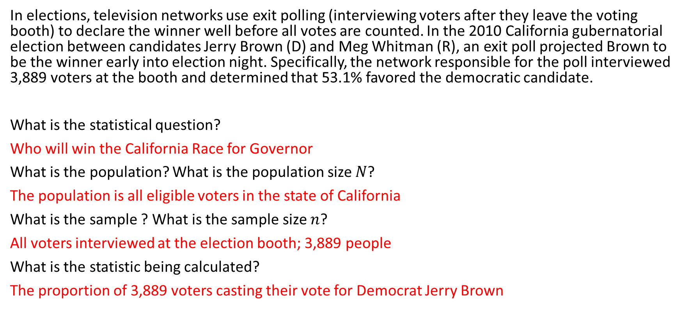
Warm Up
In elections, television networks use exit polling (interviewing voters after they leave the voting booth) to declare the winner well before all votes are counted. In the 2010 California gubernatorial election between candidates Jerry Brown (D) and Meg Whitman (R), an exit poll projected Brown to be the winner early into election night. Specifically, the network responsible for the poll interviewed 3,889 voters at the booth and determined that 53.1% favored the democratic candidate.
What is the statistical question?
Who will win the California Race for Governor
What is the population? What is the population size $N$?
The population is all eligible voters in the state of California
What is the sample ? What is the sample size $n$?
All voters interviewed at the election booth; 3,889 people
What is the statistic being calculated?
The proportion of 3,889 voters casting their vote for Democrat Jerry Brown

Slide 4
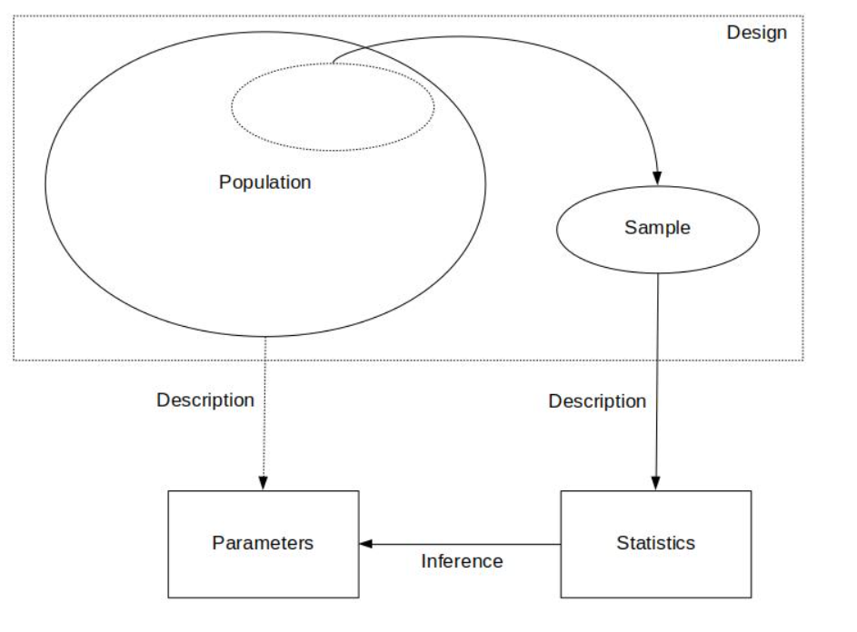
Recap:
Design – the goal/statistical question we want to answer and how we plan to obtain our data
Description – a preliminary exploration and summary of the data
Inference – using statistics to make decisions or predictions about the data

Slide 5
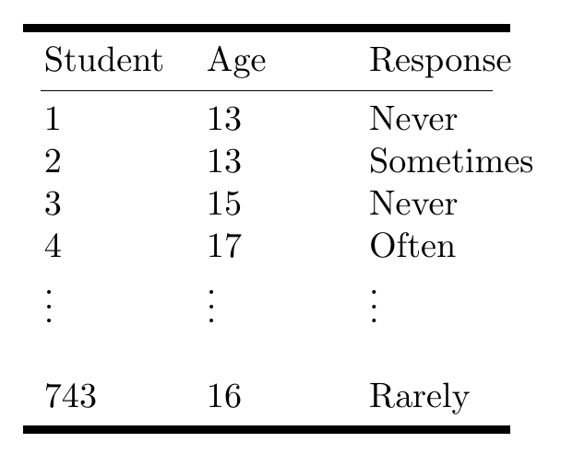
Descriptive statistics
Ex. Are teens distracted by their cell phones? A study conducted by the Pew Research center surveyed 743 U.S teenagers ages 13-17 to understand how cell phones in class impacted their ability to concentrate. Each student was asked to rate the impact of cell phone use on their concentration based on a Likert scale
Methods for summarizing, visualizing and characterizing data
The data can be from samples OR populations
Goal: simplify the data without distorting or losing information
Summaries are easier to understand
Possible Responses: Never, Rarely, Sometimes, Often

Slide 6
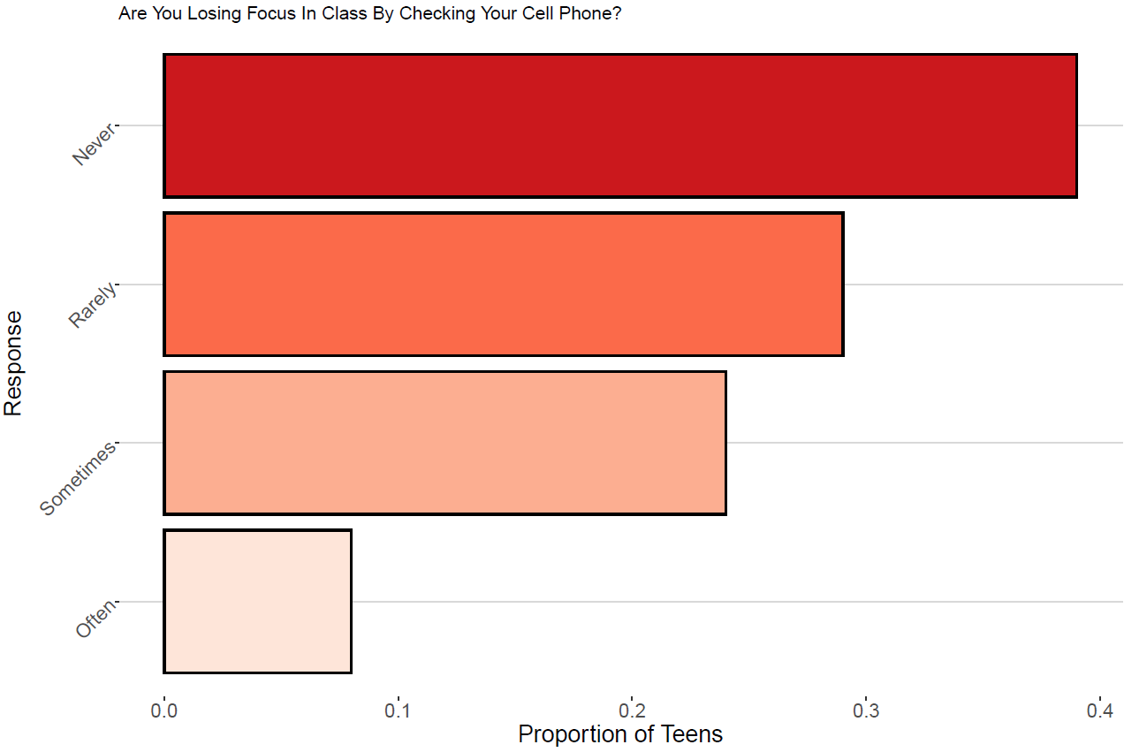

Slide 7

Features of Distributions
A distribution of a variable gives (a) the values that occur and (b) how often each value occurs
Features of A Distribution
Categorical Variables:
Modal category – the category with the highest frequency
Quantitative Variables:
Shape – do observations cluster into certain areas, are values spread out or more densely packed together?
Center – where is the middle point on the distribution, where does a typical value fall?
Variability – how tightly to observations cluster around the center of the distribution

Slide 8
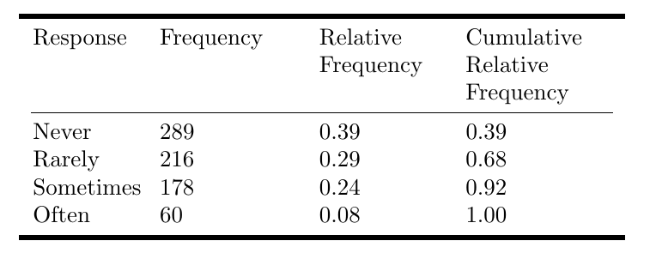
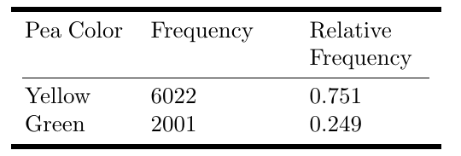
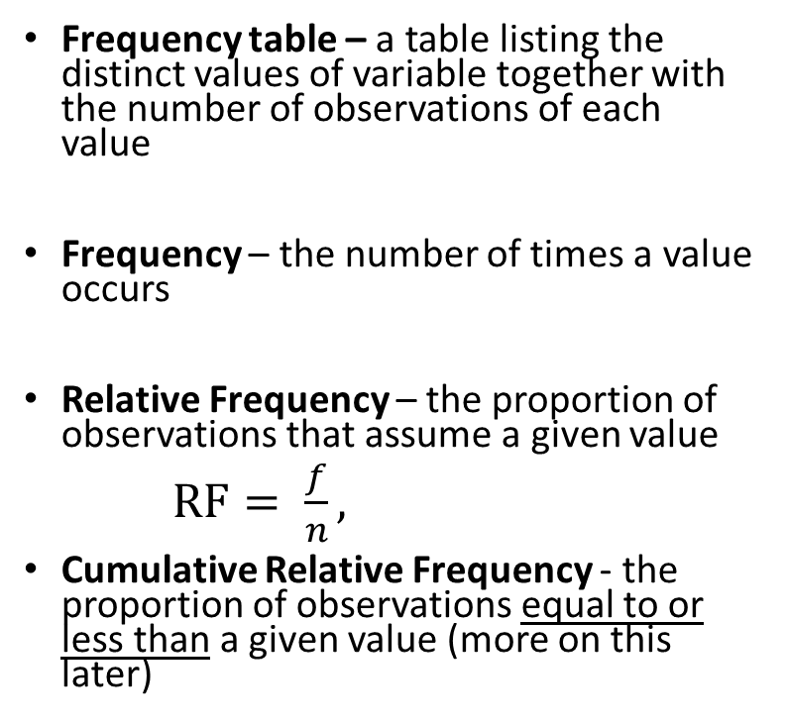
Displaying Distributions: Frequency Tables
Ex. Are teens distracted by their cell phones?
Frequency table – a table listing the distinct values of variable together with the number of observations of each value
Frequency – the number of times a value occurs
Relative Frequency – the proportion of observations that assume a given value
$RF= \frac{f}{n},$
Cumulative Relative Frequency - the proportion of observations equal to or less than a given value (more on this later)
Ex. Mendels Pea Plants - In one of Gregor Mendel’s classic studies,
he bred 8023 pea plants and observed the color of the pea pods.

Slide 9


Try it out: Computing Frequencies
Roll a six-sided die $n=10$ times and record the number rolled each time
Data = 1,2,3,3,4,4,4,5,6,6

Slide 10
Frequency Tables for Continuous Variables
The number of possible values is usually very large
Convert continuous values into discrete groups (sometimes called bins):
Steps:
Divide the range of the variable into a set of non-overlapping intervals
Count the number of values that fall into each interval

Slide 11
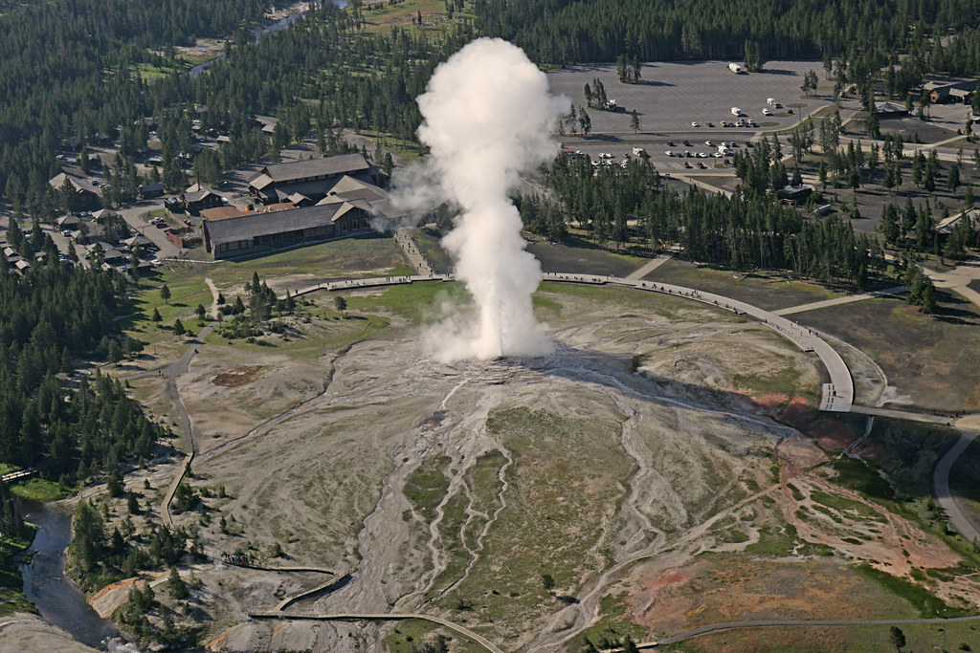
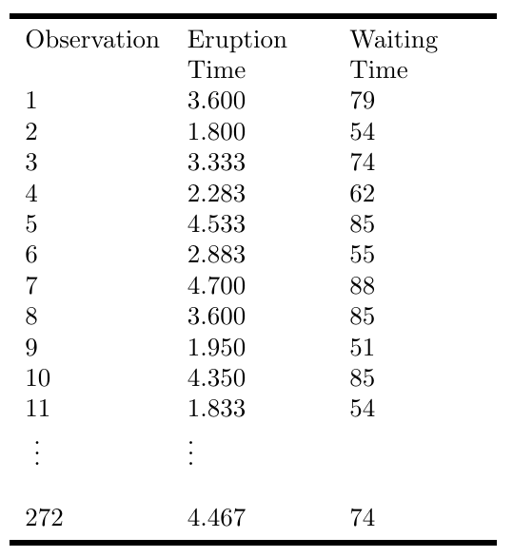
Example: Old Faithful Eruption Times

Slide 12
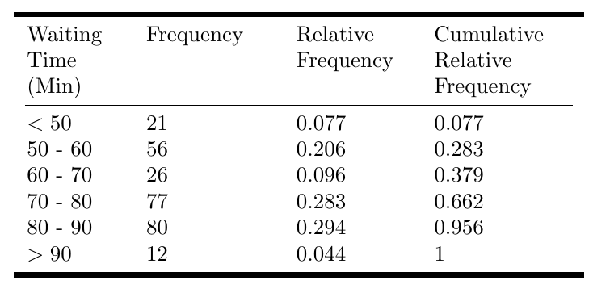
Old Faithful Eruption Times: Frequency Table

Slide 13
Visualizing Distributions of Categorical Data
Pie Charts - a circle divided into ‘slices’ corresponding to each category. The size of a slice shows the proportion of observations in a category
Bar graph – displays a vertical bar for each category. The height of the bar shows the percentages of observations in the category
Pareto Chart - a bar chart with the categories ordered by decreasing frequency

Slide 14
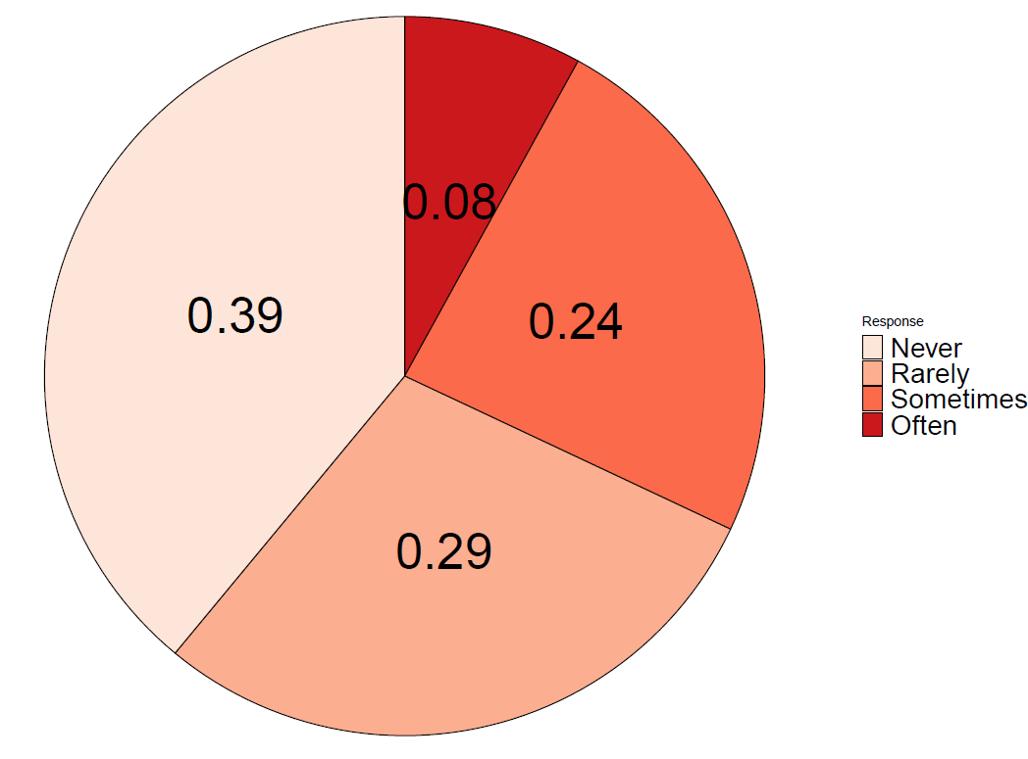
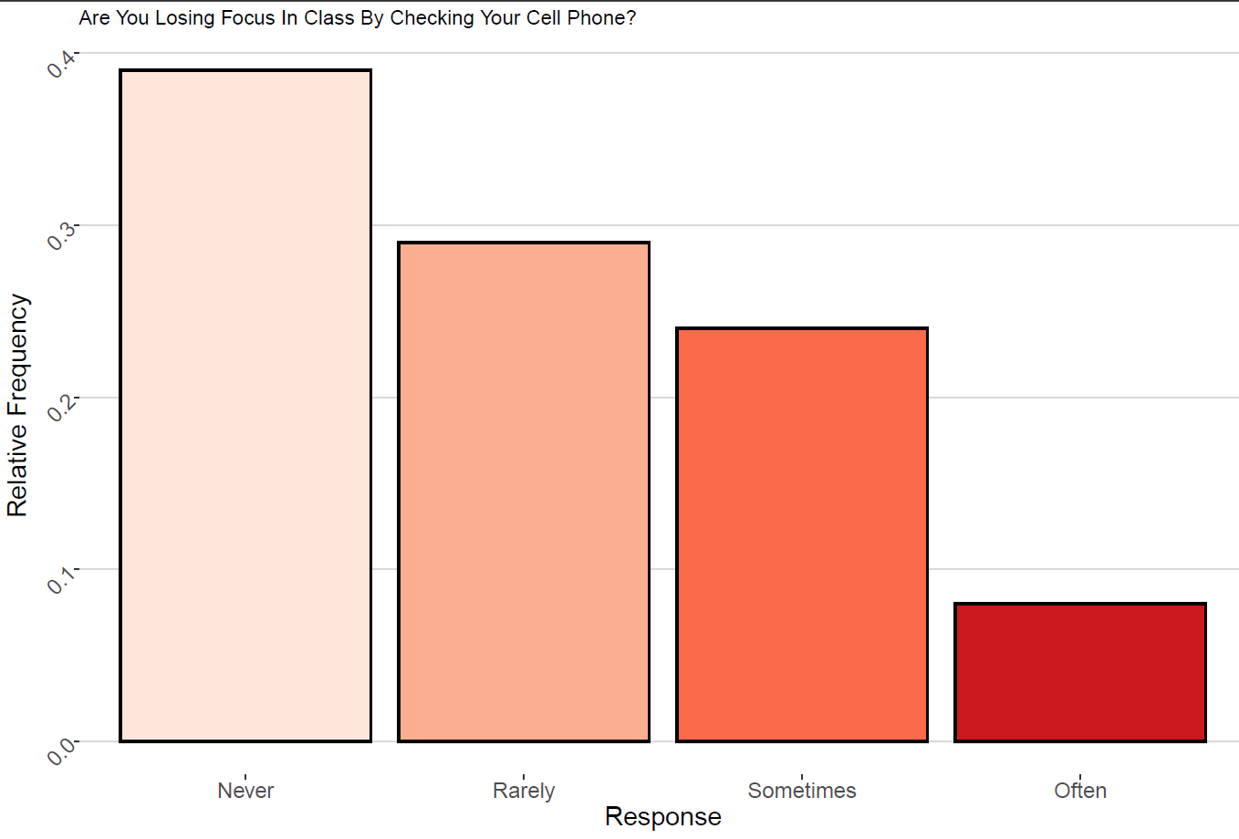

Slide 15
Visualizing Distributions: Quantitative Variables
Dot plots – shows a dot for each observation placed above the value for that observation
Steps to construct a dot plot
Draw a horizontal line and mark the line with regular values of the variable
For each observation, place a dot above its value on the number line
Works best with quantitative discrete data
Doesn’t work well if the variable is continuous and takes on many distinct values…
For continuous data, the values may need to be round to the nearest tenth or integer

Slide 16
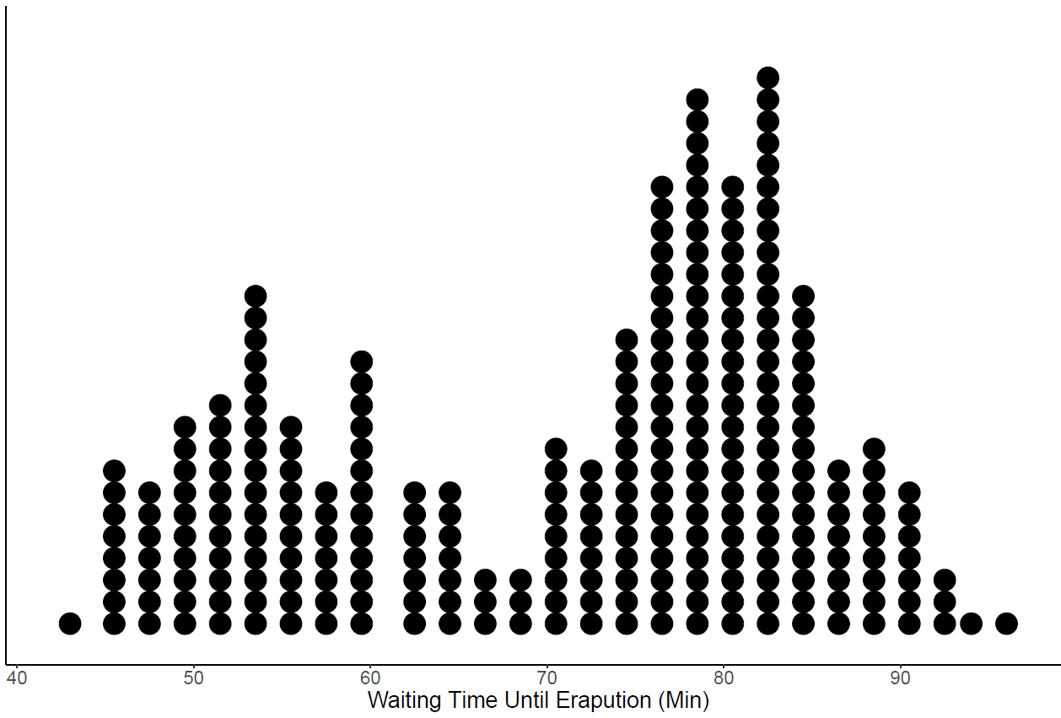

Slide 17
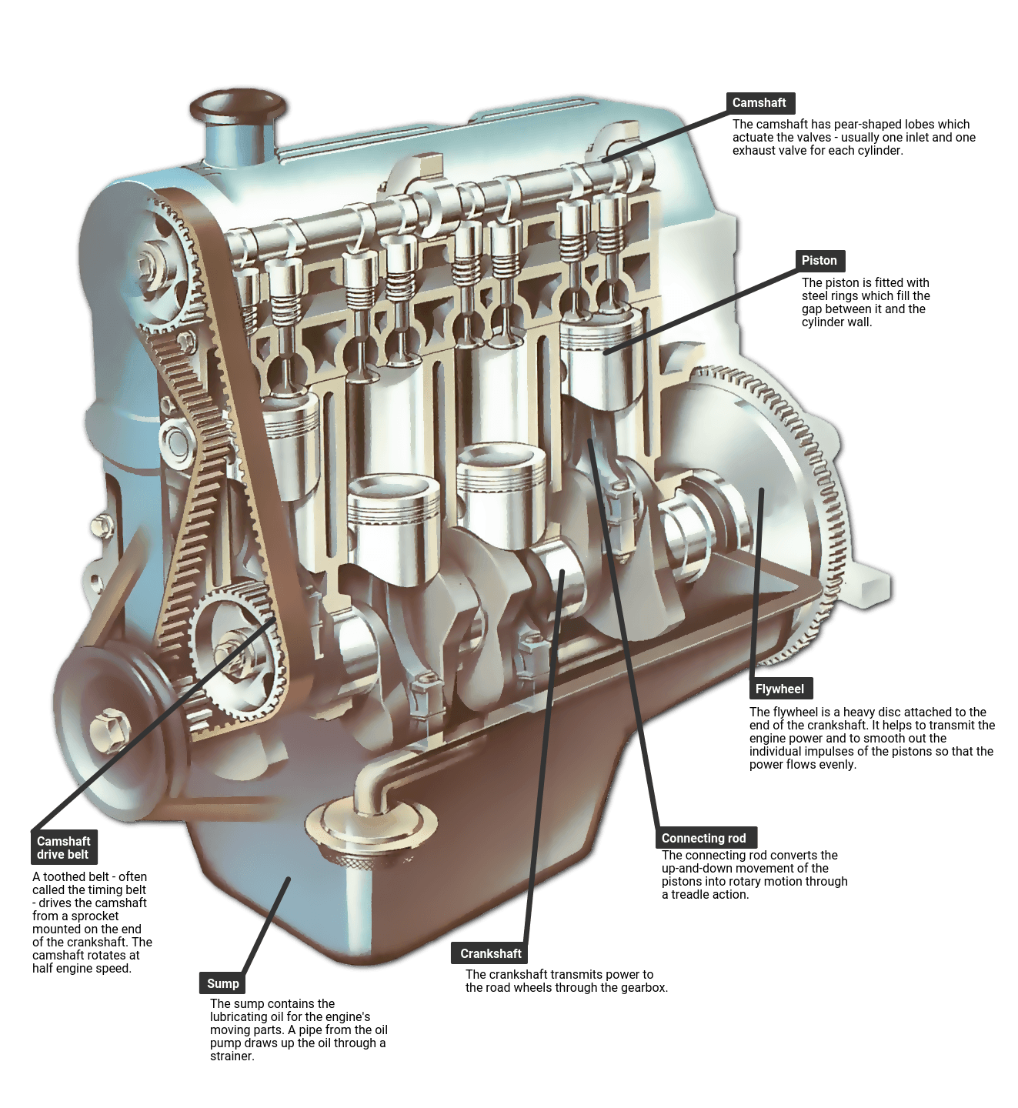
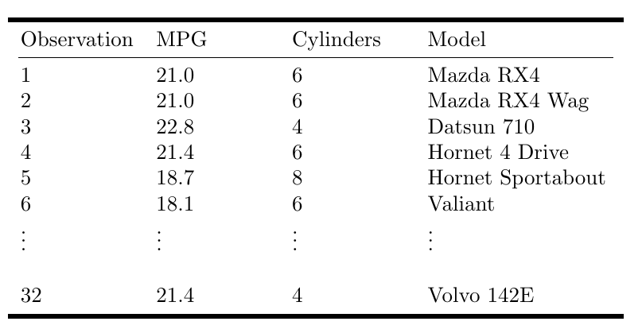
Example: MPG and Engine Cylinders

Slide 18
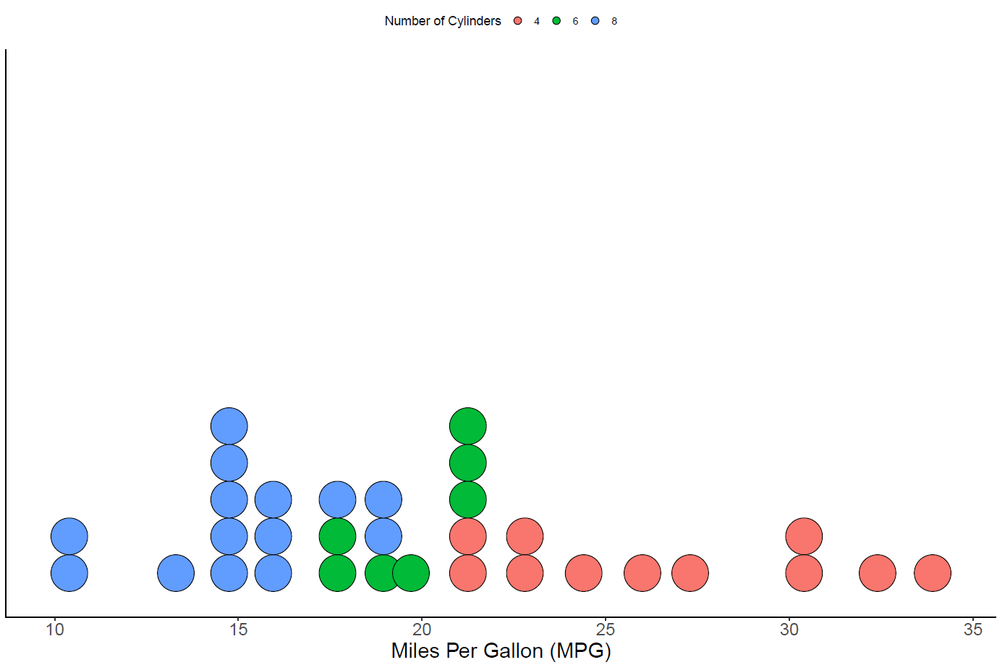

Slide 19
Visualizing Distributions: Quantitative Variables
Stem and leaf plot – like a dot plot, a stem and leaf diagram also displays individual observations.
Stem – all the digits in an observation except the last digit
Leaf – the last digit in an observation
Steps to construct a stem and leaf plot
Sort the data in order from smallest to largest.
Place the stems in a column in increasing order
Place a vertical line to the right of the stems
To the right of the vertical line, fill in the leaves that correspond with each stem in increasing order
82
Stems
Leaves
8 2

Slide 20
Example: MPG

Slide 21
Try it out: Stem and leaf plot
Data = 4.2, 3.8, 4.6, 3.2, 2.7, 8.2, 9.1, 0.2, 1.2, 6.2

